Slide 1
Apache Spark

Slide 2
Hadoop(Bigdata)
What is bigdata?
Big data is a field that treats ways to analyze, systematically extract information from, or otherwise deal with data sets that are too large or complex to be dealt with by traditional data-processing application software.

Slide 3
Compare the Industry -> lots and lots of software -> domain -> lots and lots of data that generates from those software's(Data analysis)
To handle those kind of data -> Database -> best medium to handle the data -> data volume -> traditional architecture its not supporting up to the mark
Structured -> for the fast and easy data computation with data
Unstructured
Semi-Structured

Slide 4
Database -> until you reach the maximum capacity
Publishing college result -> how you college website it will preform
Will you agree the same situation in the business -> some proper medium to handle those large amount of data -> Bigdata

Slide 5
Bigdata
To handle those large amount of data
Hardware -> database
Bigdata -> there is no such limitations that will be available for bigdata
If there is no limitations -> how much of hardware that will it required
Bigdata -> Architecture that will run on the cluster computing

Slide 6
Cluster -> Group of machine that are connected via some network
A computer cluster is a set of computers that work together so that they can be viewed as a single system.
Unlike grid computers, computer clusters have each node set to perform the same task, controlled and scheduled by software
A distributed system is a system whose components are located on different networked computers, which communicate and coordinate their actions by passing messages to one another from any system.

Slide 7
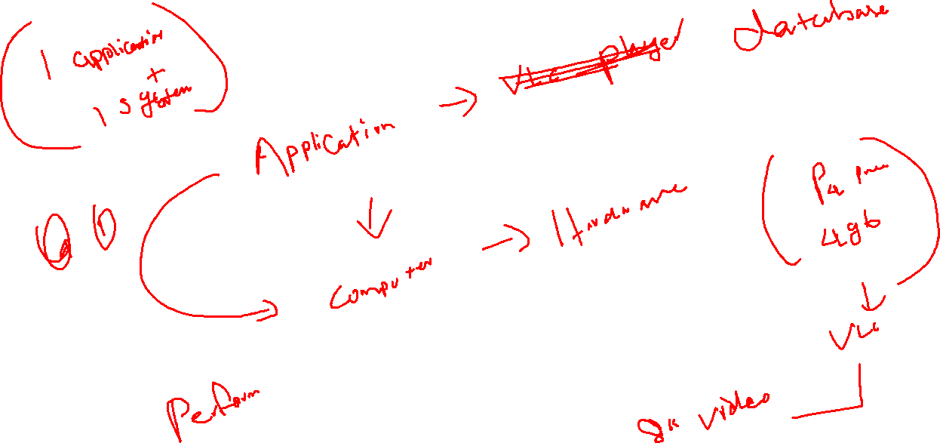

Slide 8
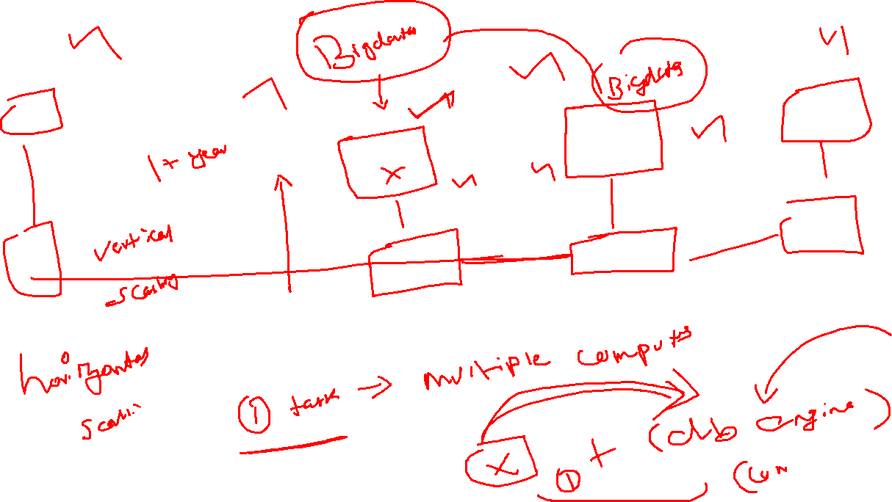

Slide 9

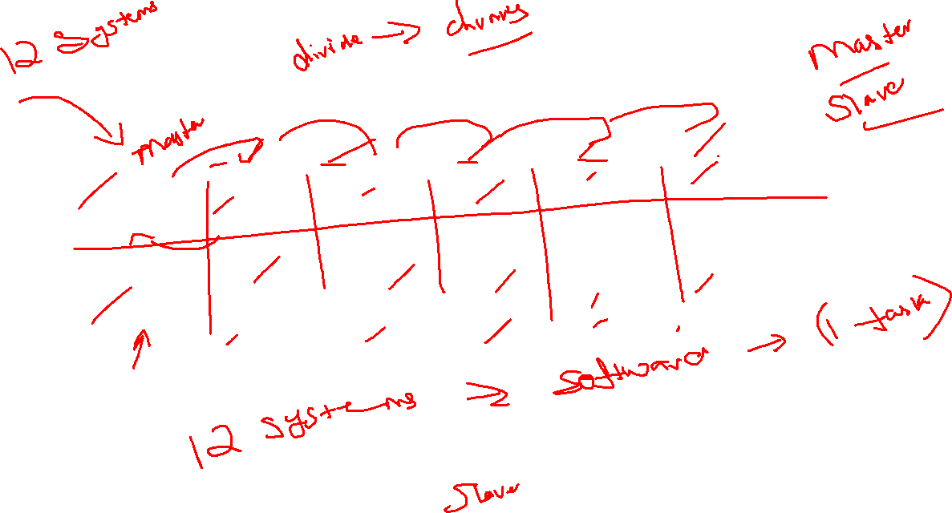

Slide 10
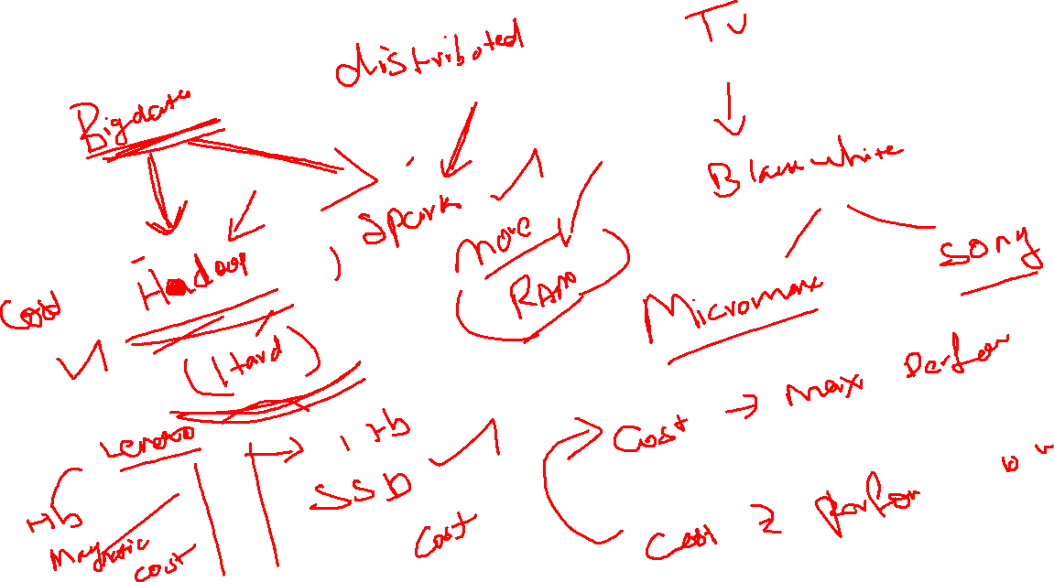
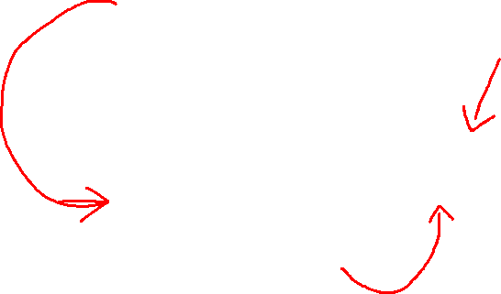

Slide 11
Hadoop
Distributed -> Software –> fetch the resources from the multiple computer
Treat those logical resource(CPU + RAM+ Hard drive) as a single component to execute a single task
2 major ->
Computing (CPU + RAM) -> MAPREDUCE(distributed processing model)
Storage -> HDFS(Hadoop distributed File System)(distributed storage model) -> 20 PB

Slide 12
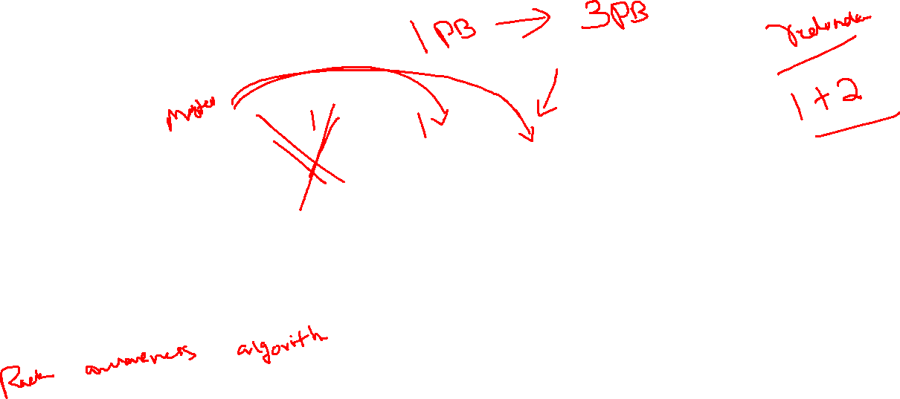
4 Core
8gb RAM
1 TB
40 Core
80 GB RAM
10 TB
Software
Perform the Task

Slide 13
Batch processing
Stream processing

Slide 14
Hadoop -> based java programming
1.0 -> java developers -> Mapreduce -> java
2.0 -> YARN + MapReduce2
Spark -> based on Scala(Advanced version of JAVA)
Spark -> spark will work on all the programming API
Spark -> Batch processing and Stream processing of data

Slide 15
Spark + Hadoop
Developer
How to run the job
Manage the API
Administrator
setup cluster, monitor and manage the cluster

Slide 16
Practical -> LAB
Databricks
We are going to create our cluster on data bricks cloud
They wont ask you anything -> community edition

Slide 17
Apache Spark
Apache Spark is a lightning-fast cluster computing designed for fast computing
It was built on top of Hadoop MapReduce and it extends the MapReduce mode to efficiently use more types of computations which include interactive queries and Stream processing.

Slide 18
Industries are using Hadoop Extensively to analyse their datasets
The reason is that Hadoop framework is based on a simple programming model(Mapreduce) and it enable a computing solution that is scalable, flexible and fault-tolerant and cost effective
Here, the main concern in to maintain speed in processing large datasets in terms of waiting time between queries and waiting time to run the program

Slide 19
Spark was introduced by Apache Software foundation for speeding up the Hadoop computational software process
As against the common belief, spark is not the modified version of Hadoop and is not really dependent on Hadoop because it has its own cluster management
Hadoop is just one of the way to implement Spark
Spark uses the Hadoop in 2 ways
One is for storage
Second one is process, you can run the spark on top of Mapreduce

Slide 20
Features of spark
Speed -> Spark helps to run an application in Hadoop Cluster up to 100 times faster in memory and 10 times faster when its running on disk. This is possible by reducing thee number of read/write operations to the disk, so its stores the intermediate processing data in memory
Supports multiple languages -> JAVA, Scala, Python -> 80- high level operators interactive queries
Advance Analytics -> Spark not only support Hadoop based jobs(mapper + reducer), SQL, streaming, Machine algorithms, R Programming and Graph algorithms

Slide 21
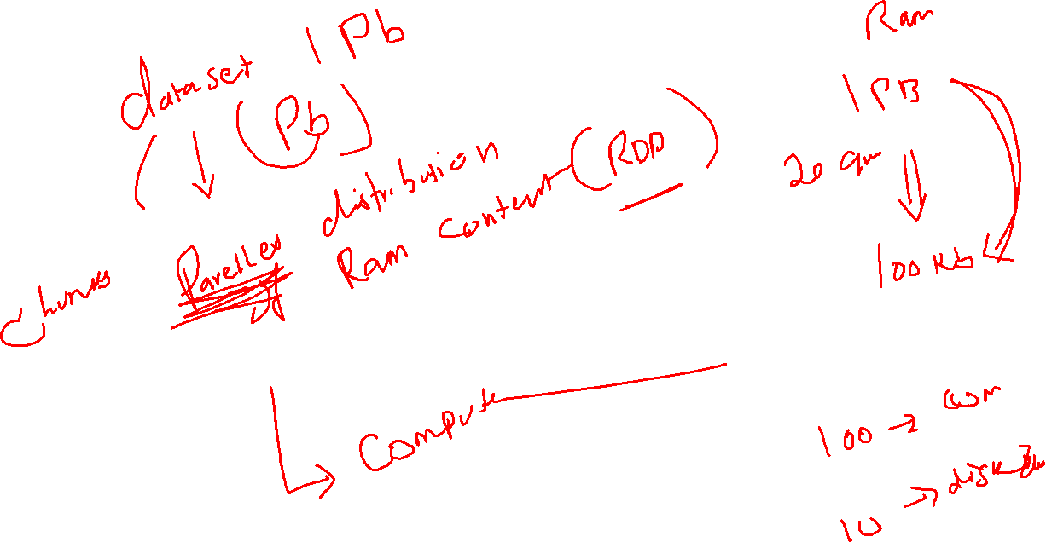

Slide 22
There are 3 ways of spark cluster deployment
Spark on Hadoop 1.0 ->
Standalone ->
Spark is developed with the help of SCALA, with the help of only the SCALA, we will deploy the Spark Cluster and do out computation needs.
What are all the storages it will supports database, cloud storage , refer the files and it will support the Hadoop Storage(HDFS)

Slide 23

Combination of multiple queries
Because of DISK I/O is the to transfer the intermediate results between multiple stages

Slide 24
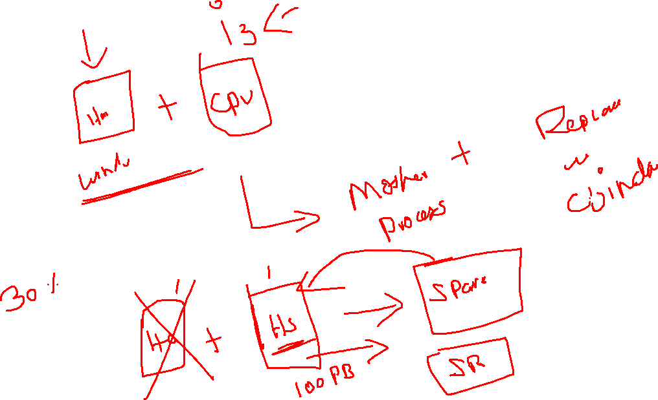

Slide 25
Hadoop 1.0
MapReduce
HDFS

Slide 26
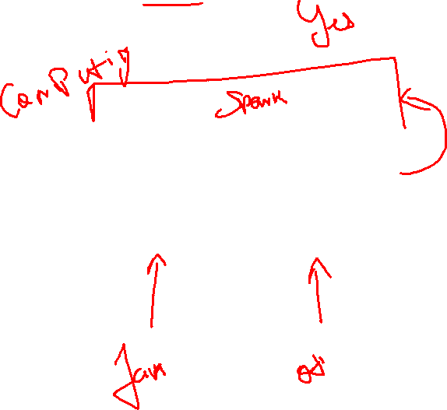
Hadoop 2.0
MapReduce
YARN
HDFS

Slide 27
Components of Spark
Spark Core -> unstructured + semi structured + structured
Spark SQL -> Structured
Spark Streaming -> Streaming
MiLB -> Machine Learning
Graphx -> Graph algorithms
R -> R Programming

Slide 28
Spark Components
Spark Core -> unstructured + semi structured + structured
RDD
Spark SQL -> Structured
Data frame + datasets
Spark Streaming -> Streaming
Streaming

Slide 29
Spark Abstraction
RDD
DAG

Slide 30
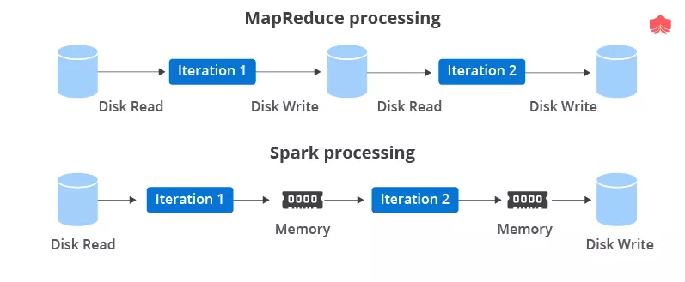

Slide 31
RDD is the basic component to do you computations on Spark
RDD is the collection of Objects that is immutable in nature

Slide 32
RDD
Resilient Distributed Dataset
RDD -> fundamental data structure of the spark
Immutable collection of objects
Each RDD is divided in to logical partitions, which may be computed on different nodes of the cluster at the same time
RDD can contained Python, Java or Scala objects including user defined class
RDD is the read only partitioned collection of records
RDD can be created through an deterministic operations on data which is available on stable storage or other RDDS
RDD is by default fault tolerant in nature that can be operated in parallel

Slide 33
Large amount -> database will reach the maximum limitation
Data warehouse
Bigdata
To handle the technology bigdata
Hadoop
Spark

Slide 34
Hadoop -> to work with Hadoop -> Java Program
If you are the non java programmer -> API
Tools based approach -> CLI(Command based task)
Sqoop -> to import/export the data from the databases
Hive -> data warehousing tool -> MapReduce -> HQL(SQL) -> HDFS
HBase -> NoSQL Database -> Columnar table format
Pig -> Latin
Kafka -> handle the streaming data
Zookeeper -> Cluster Manage

Slide 35
Hadoop -> our comfort(Program interface) -> Tools based
Spark -> API -> libraries

Slide 36
RDD
RDD -> immutable collection of objects(Array Format)
Can be created via
By means of parallelizing the objects that is available on your program
It will get the data from programmatic interface and distribute the data in the spark cluster
Refer the Existing data sets
We gave the reference to the object that is available on the cluster storage

Slide 37
Spark
Transformation -> transformations are lazy
Action

Slide 38
Transformations and Actions
On top of RDD if you want to do the data manipulation, you need to follow the procedures that will be available only on spark Transformation
If you want to gather the data from RDD means you need to go for Actions

Slide 39
map(func)
Return a new distributed dataset formed by passing each element of the source through a function func.

Slide 40
RDD
Coalesce
Partition
repartition

Slide 41
Spark DataFrames
A DataFrame is a distributed collection of data, which is organized into named columns
Conceptually it is nothing but the relational database tables with good optimization techniques
A DataFrame can be constructed from an array of different sources such as Hive Tables, Structured data files, external databases or an existing RDDs.
SparkSession -> Driver program that is used to communicate with spark architecture

Slide 42
12.55
https://github.com/karthick1808/Spark-stage3/tree/main/03-Spark%20DFs

